Slide 1


Topup DOCUMENTATION

Slide 2

TopUP Description
Quoi, comment, pour quoi
5 BINs
Je veux utiliser ma propre carte bancaire pour charger mon compte
J’entre l’ensemble des coordonnées de ma carte, numéro de carte, Date, CVV2 (i.e. 23 char) comme un paiement e-commerce classique pour réaliser un paiement.
Depuis la DSP2, sauf cas exceptionnel, une demande d’authentification (challenge) est systématiquement demandé (3DS) afin que le paiement se réalise.
A chaque fois que je réalise un TopUP de cette façon la banque de la carte est susceptible de me demander un challenge.
TopUP 3DS
(à l’initiative du Porteur)
5 BINs
Je souhaite enregistrer ma carte pour ne plus avoir à saisir les 23 caractères de la carte
Xpollens propose 2 méthodes pour que le porteur enregistre sa propre carte bancaire
SOIT : une api spécifique d’enregistrement permettant à l’utilisateur d’enregistrer sa carte sans topUP (demande de renseignement à 0€)
SOIT : une option ‘oneclic’ dans l’api TopUP 3DS permettant d’enregistrer la carte (à la volée) en même temps que le topUP
Card Register
&
TopUP oneclic
5 BINs
Je peux autoriser/permettre qu’on me prélève sur ma carte.
Pour cela, le préalable est que ma carte soit d’abord enregistrée (cf-ci-dessus)
SOIT par l’api spécifique d’enregistrement permettant à l’utilisateur d’enregistrer sa carte sans topUP (demande de renseignement à 0€)
SOIT par une option ‘subscription’ dans l’api TopUP permettant d’enregistrer la carte (à la volée) en même temps que le topUP
TopUP
(à l’initiative du commerçant)

Slide 3




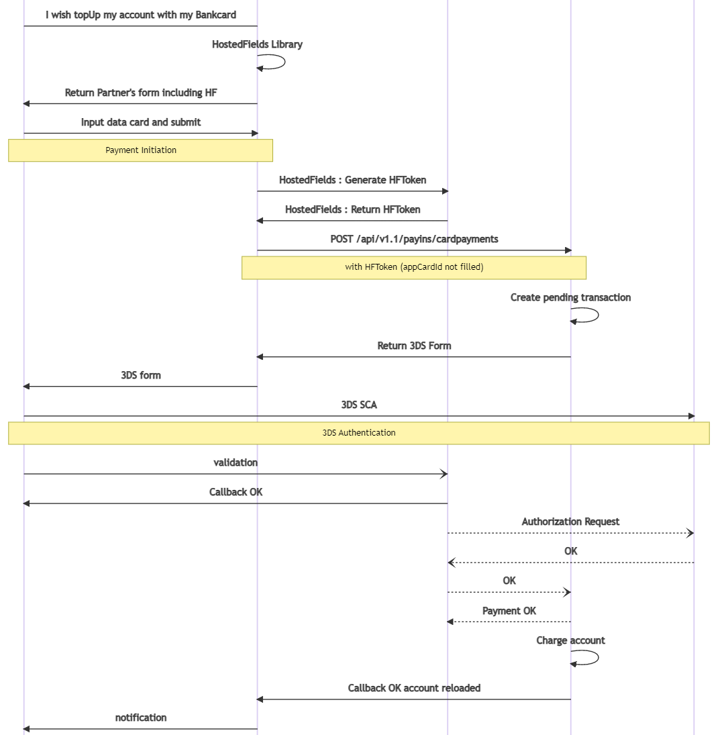

TopUP my account
PARTNER
With my bank card and 3DS
This endpoint is used to create top up request with 3DS v2. The holder of the Xpollens account can add money to his Xpollens account using his bank card. Thus, he will debit his bank account and credit his Xpollens account with the topup. If fees must be attached to this transaction, you can fill in the "Fee" parameter in the body of the request with the amount of the fees. The bank card holder will be debited for the "Amount+Fee“
Create a topUp with my bank card
5 BINs
API
/api/v1.1/payins/cardpayments
Note
Texte
POST
Cf. below
{"Message": "string",
"OrderId": "string",
"UrlReturn": "string",
"Status": "string",
"ExecMessage": "string",
"ExecCode": "string",
"AuthenticationFormHtml": "string",
"TermsAndConditionsValidationDate": "1970-01-01T00:00:00.000Z",
"Payer": { "Name": "string", "Email": "string", "UserAgent": "string", "UrlReferrer": "string", "IpAddress": "string" },
"Card": { "HFToken": "string", "AppCardId": "string", "Status": "string", "Hint": "string", "ExpiryDate": "string", "IsActive": false },
"Payments": [{"OrderId": "string", "Amount": 0, "Fee": 0, "Beneficiary": { "AppAccountId": "string"}, "Message": "string", "Status": "string" } ],
"DalenysData": {"TransactionId": "string", "ExecCode": "string", "Message": "string", "Currency": "string", "ThreeDSecure": "string", "ThreeDSAuthenticationStatus": "string", "AuthorizationNumber": "string", "CardNetwork": "string", "CardValidityDate": "string", "CardCountry": "string", "CardFullname": "string", "CardThreeDSecureEnrolled": "string", «ThreeDSecureVersion": 0, "ThreeDSGlobalStatus": "string", "Version": "string", "CardType": "string" },
"SubscriptionTopUp": false
}

Slide 4
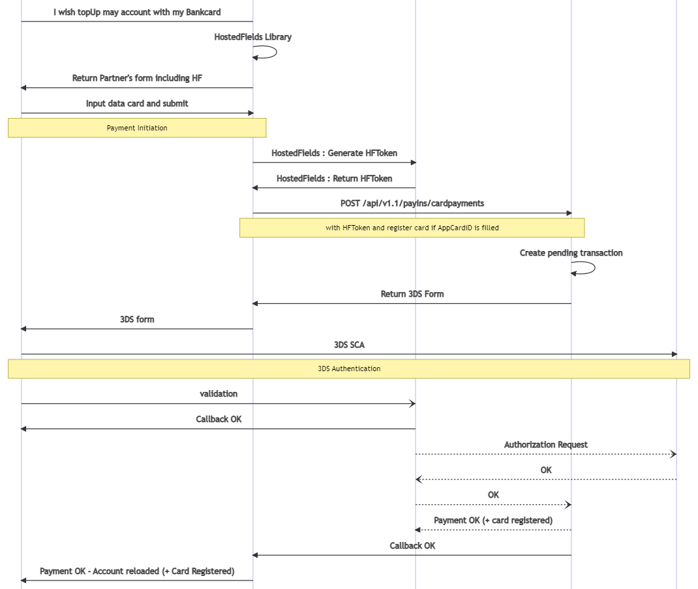
TopUP my account
PARTNER
With my bank card and 3DS + registration during payment
This endpoint is used to create top up request with 3DS v2. The holder of the Xpollens account can add money to his Xpollens account using his bank card. Thus, he will debit his bank account and credit his Xpollens account with the topup. If fees must be attached to this transaction, you can fill in the "Fee" parameter in the body of the request with the amount of the fees. The bank card holder will be debited for the "Amount+Fee“
To register the bank card during payment, you must, in the body of the request, in the "Card" parameter, specify the "AppCardId" parameter. It will be this "AppCardId" which will be called later for the top up oneclik. If there is no need to register the bank card during payment, then you should not specify "AppCardId". This parameter is optional.
Create a topUp with my bank card
5 BINs
API
/api/v1.1/payins/cardpayments
Note
Texte
POST
Cf. below
{"Message": "string",
"OrderId": "string",
"UrlReturn": "string",
"Status": "string",
"ExecMessage": "string",
"ExecCode": "string",
"AuthenticationFormHtml": "string",
"TermsAndConditionsValidationDate": "1970-01-01T00:00:00.000Z",
"Payer": { "Name": "string", "Email": "string", "UserAgent": "string", "UrlReferrer": "string", "IpAddress": "string" },
"Card": { "HFToken": "string", "AppCardId": "string", "Status": "string", "Hint": "string", "ExpiryDate": "string", "IsActive": false },
"Payments": [{"OrderId": "string", "Amount": 0, "Fee": 0, "Beneficiary": { "AppAccountId": "string"}, "Message": "string", "Status": "string" } ],
"DalenysData": {"TransactionId": "string", "ExecCode": "string", "Message": "string", "Currency": "string", "ThreeDSecure": "string", "ThreeDSAuthenticationStatus": "string", "AuthorizationNumber": "string", "CardNetwork": "string", "CardValidityDate": "string", "CardCountry": "string", "CardFullname": "string", "CardThreeDSecureEnrolled": "string", «ThreeDSecureVersion": 0, "ThreeDSGlobalStatus": "string", "Version": "string", "CardType": "string" },
"SubscriptionTopUp": false
}

Slide 5
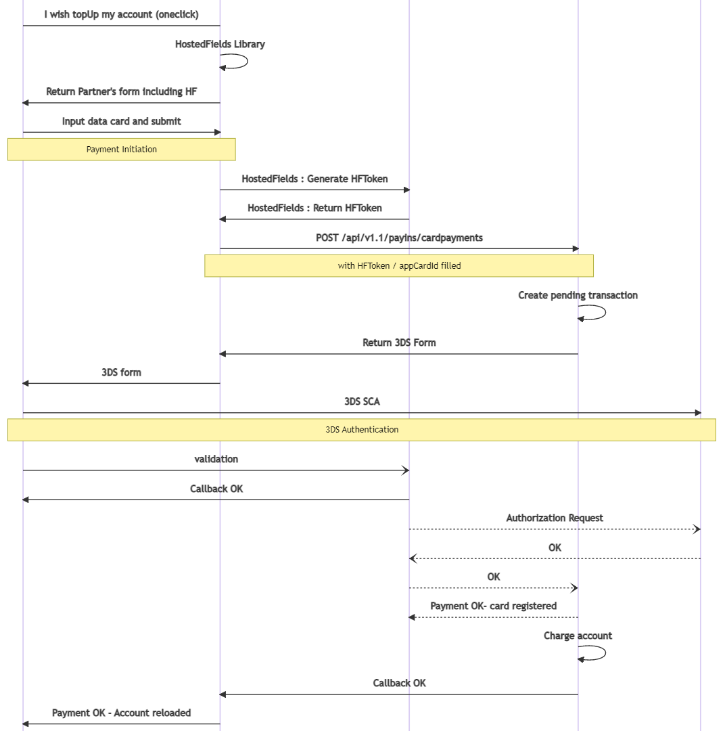
TopUP my account
PARTNER
With my bank card and 3DS by oneclick
This endpoint is used to create top up request with 3DS v2. The holder of the Xpollens account can add money to his Xpollens account using his bank card. Thus, he will debit his bank account and credit his Xpollens account with the topup. If fees must be attached to this transaction, you can fill in the "Fee" parameter in the body of the request with the amount of the fees. The bank card holder will be debited for the "Amount+Fee“
To create a top up oneclick, you must, in the body of the request, add and fill in the "AppCardId" parameter instead of the "HFToken" parameter". This will allow you to directly call the previously registered bank card. By default, a 3DS v2 authentication is asking
Create a topUp with my bank card
5 BINs
API
/api/v1.1/payins/cardpayments
Note
Texte
POST
Cf. below
{"Message": "string",
"OrderId": "string",
"UrlReturn": "string",
"Status": "string",
"ExecMessage": "string",
"ExecCode": "string",
"AuthenticationFormHtml": "string",
"TermsAndConditionsValidationDate": "1970-01-01T00:00:00.000Z",
"Payer": { "Name": "string", "Email": "string", "UserAgent": "string", "UrlReferrer": "string", "IpAddress": "string" },
"Card": { "HFToken": "string", "AppCardId": "string", "Status": "string", "Hint": "string", "ExpiryDate": "string", "IsActive": false },
"Payments": [{"OrderId": "string", "Amount": 0, "Fee": 0, "Beneficiary": { "AppAccountId": "string"}, "Message": "string", "Status": "string" } ],
"DalenysData": {"TransactionId": "string", "ExecCode": "string", "Message": "string", "Currency": "string", "ThreeDSecure": "string", "ThreeDSAuthenticationStatus": "string", "AuthorizationNumber": "string", "CardNetwork": "string", "CardValidityDate": "string", "CardCountry": "string", "CardFullname": "string", "CardThreeDSecureEnrolled": "string", «ThreeDSecureVersion": 0, "ThreeDSGlobalStatus": "string", "Version": "string", "CardType": "string" },
"SubscriptionTopUp": false
}

Slide 6
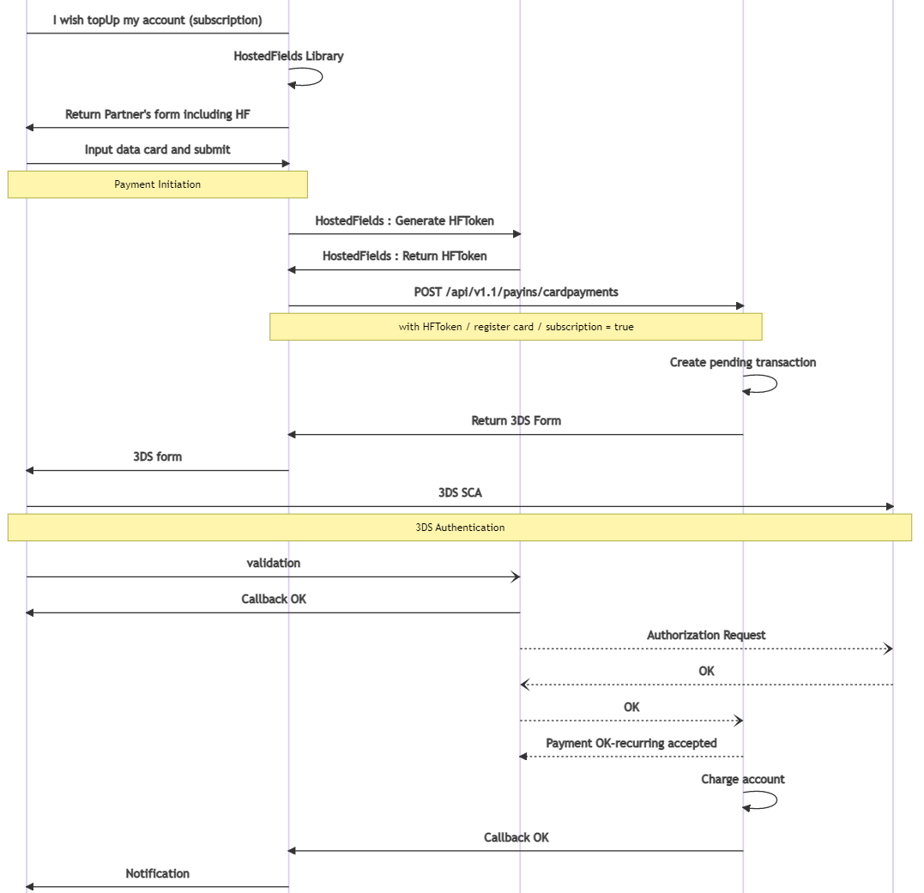
TopUP my account
PARTNER
With my bank card and 3DS + subscription
This endpoint is used to create top up request with 3DS v2. The holder of the Xpollens account can add money to his Xpollens account using his bank card. Thus, he will debit his bank account and credit his Xpollens account with the topup. If fees must be attached to this transaction, you can fill in the "Fee" parameter in the body of the request with the amount of the fees. The bank card holder will be debited for the "Amount+Fee“
You can also request a payment by subscription for recurring payment by using the subscription mode parameter. Thus, no authentication is requested
Create a topUp with my bank card
5 BINs
API
/api/v1.1/payins/cardpayments
Note
Texte
POST
Cf. below
{"Message": "string",
"OrderId": "string",
"UrlReturn": "string",
"Status": "string",
"ExecMessage": "string",
"ExecCode": "string",
"AuthenticationFormHtml": "string",
"TermsAndConditionsValidationDate": "1970-01-01T00:00:00.000Z",
"Payer": { "Name": "string", "Email": "string", "UserAgent": "string", "UrlReferrer": "string", "IpAddress": "string" },
"Card": { "HFToken": "string", "AppCardId": "string", "Status": "string", "Hint": "string", "ExpiryDate": "string", "IsActive": false },
"Payments": [{"OrderId": "string", "Amount": 0, "Fee": 0, "Beneficiary": { "AppAccountId": "string"}, "Message": "string", "Status": "string" } ],
"DalenysData": {"TransactionId": "string", "ExecCode": "string", "Message": "string", "Currency": "string", "ThreeDSecure": "string", "ThreeDSAuthenticationStatus": "string", "AuthorizationNumber": "string", "CardNetwork": "string", "CardValidityDate": "string", "CardCountry": "string", "CardFullname": "string", "CardThreeDSecureEnrolled": "string", «ThreeDSecureVersion": 0, "ThreeDSGlobalStatus": "string", "Version": "string", "CardType": "string" },
"SubscriptionTopUp": true
}

Slide 7
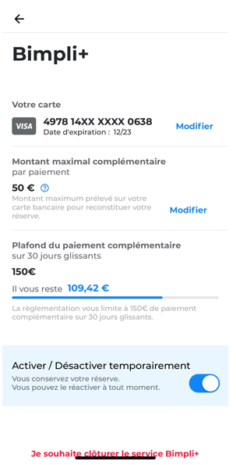
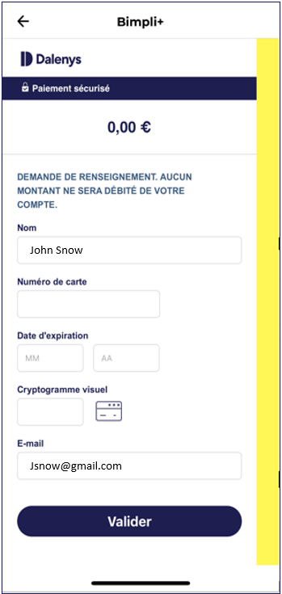
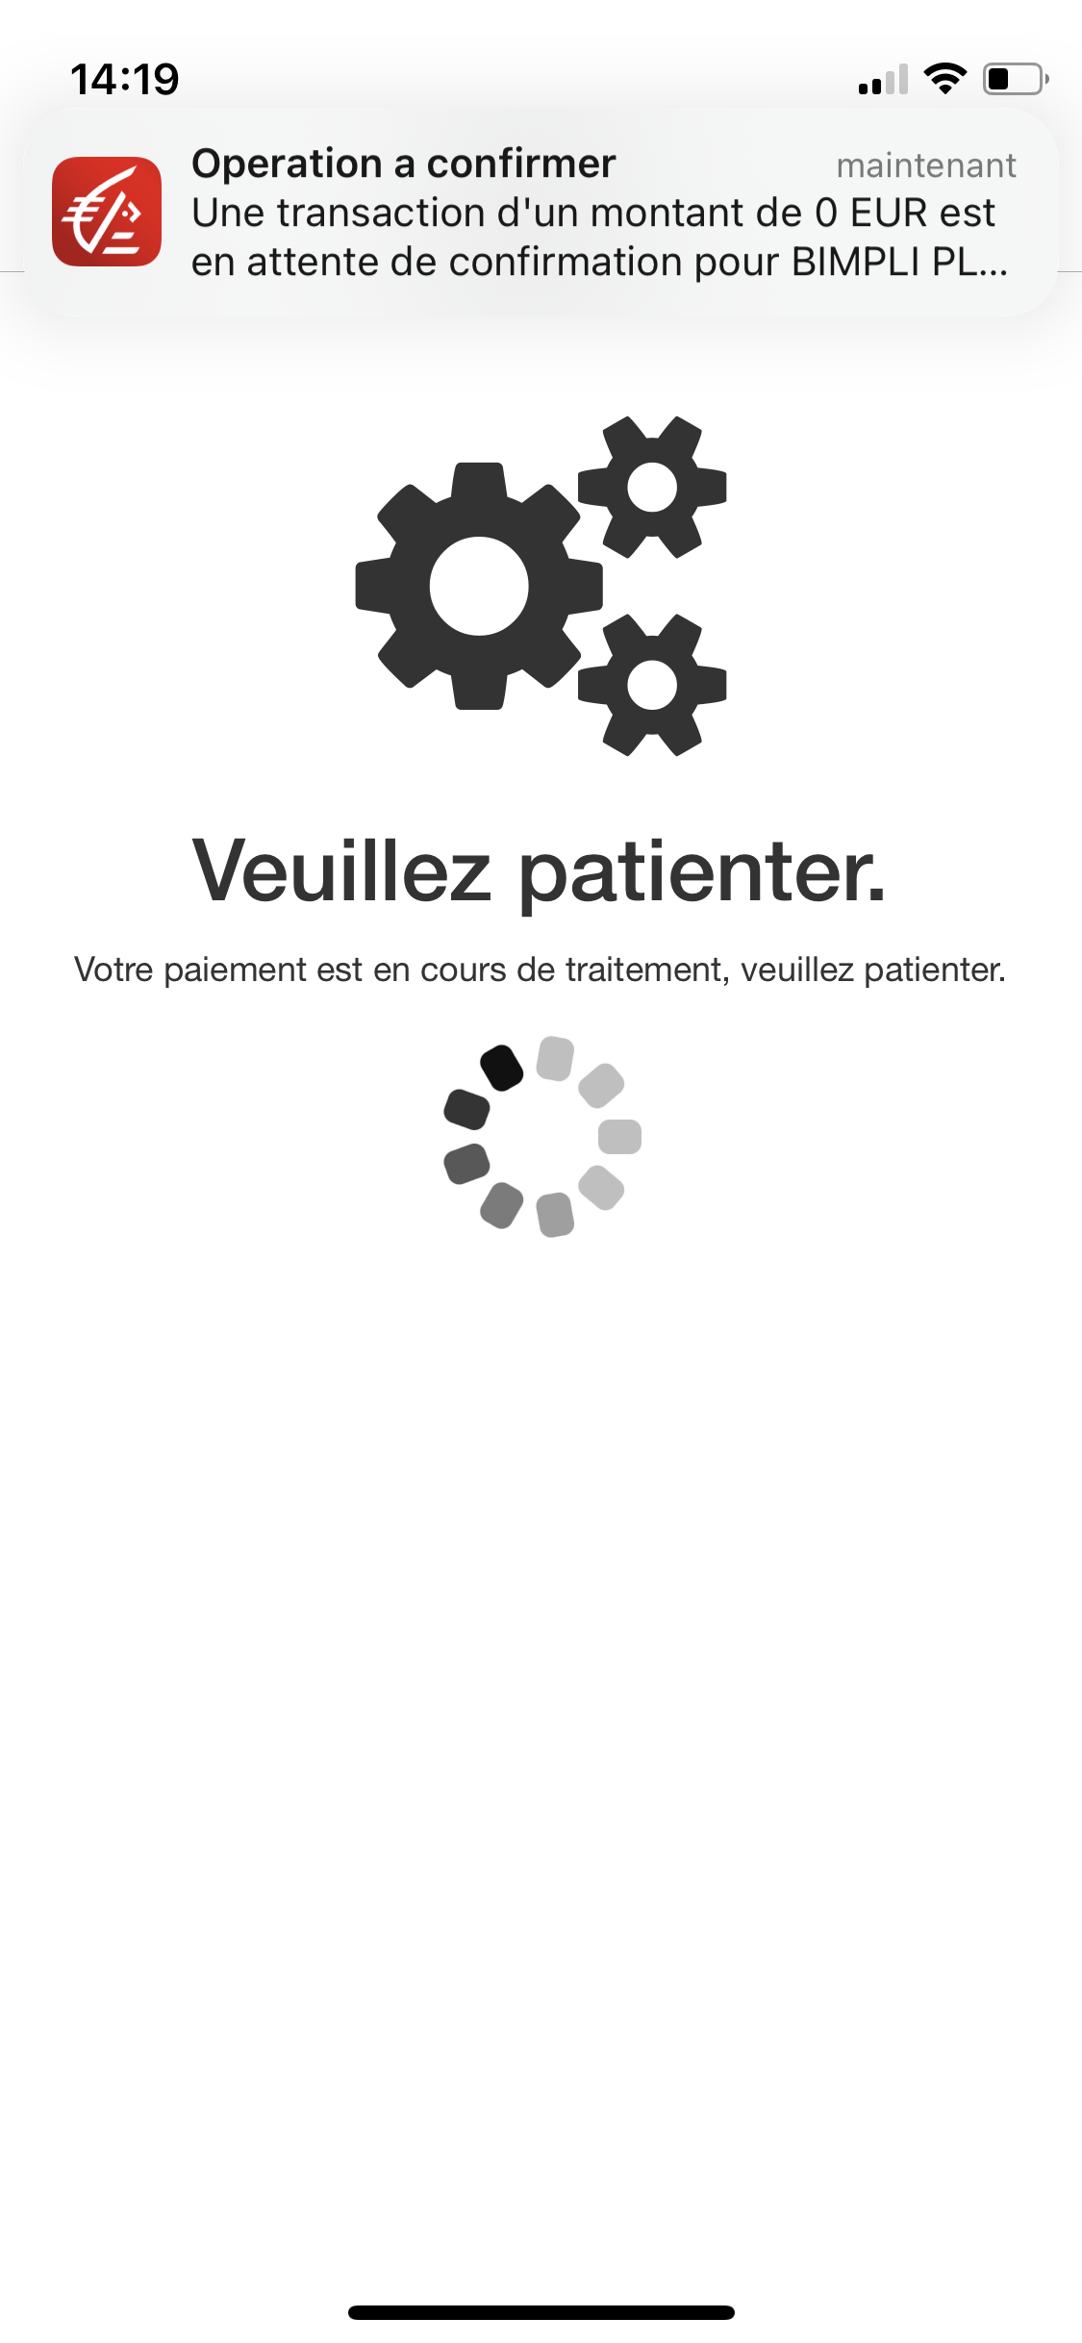
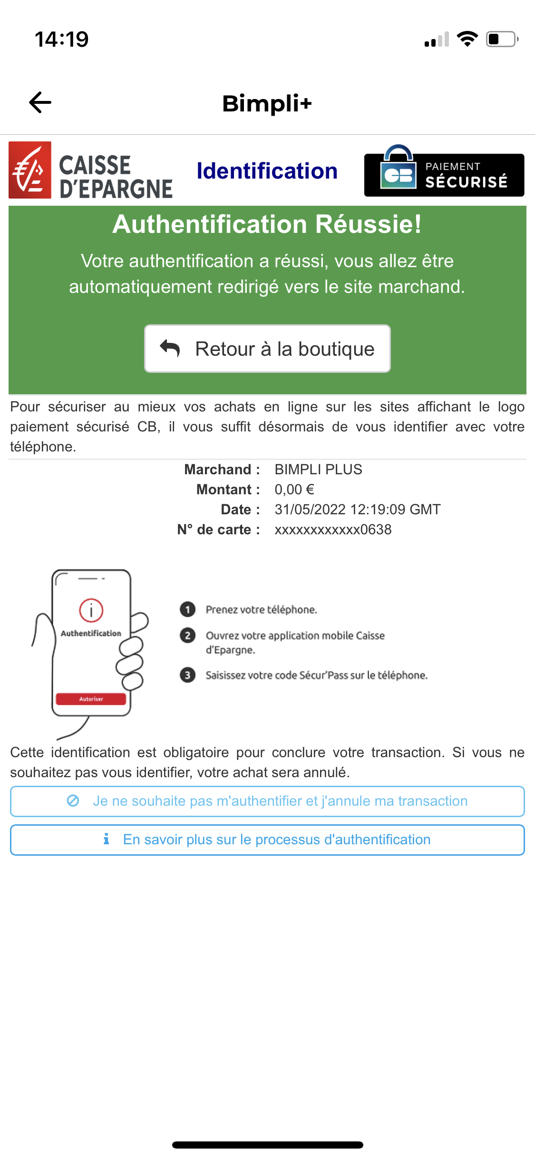
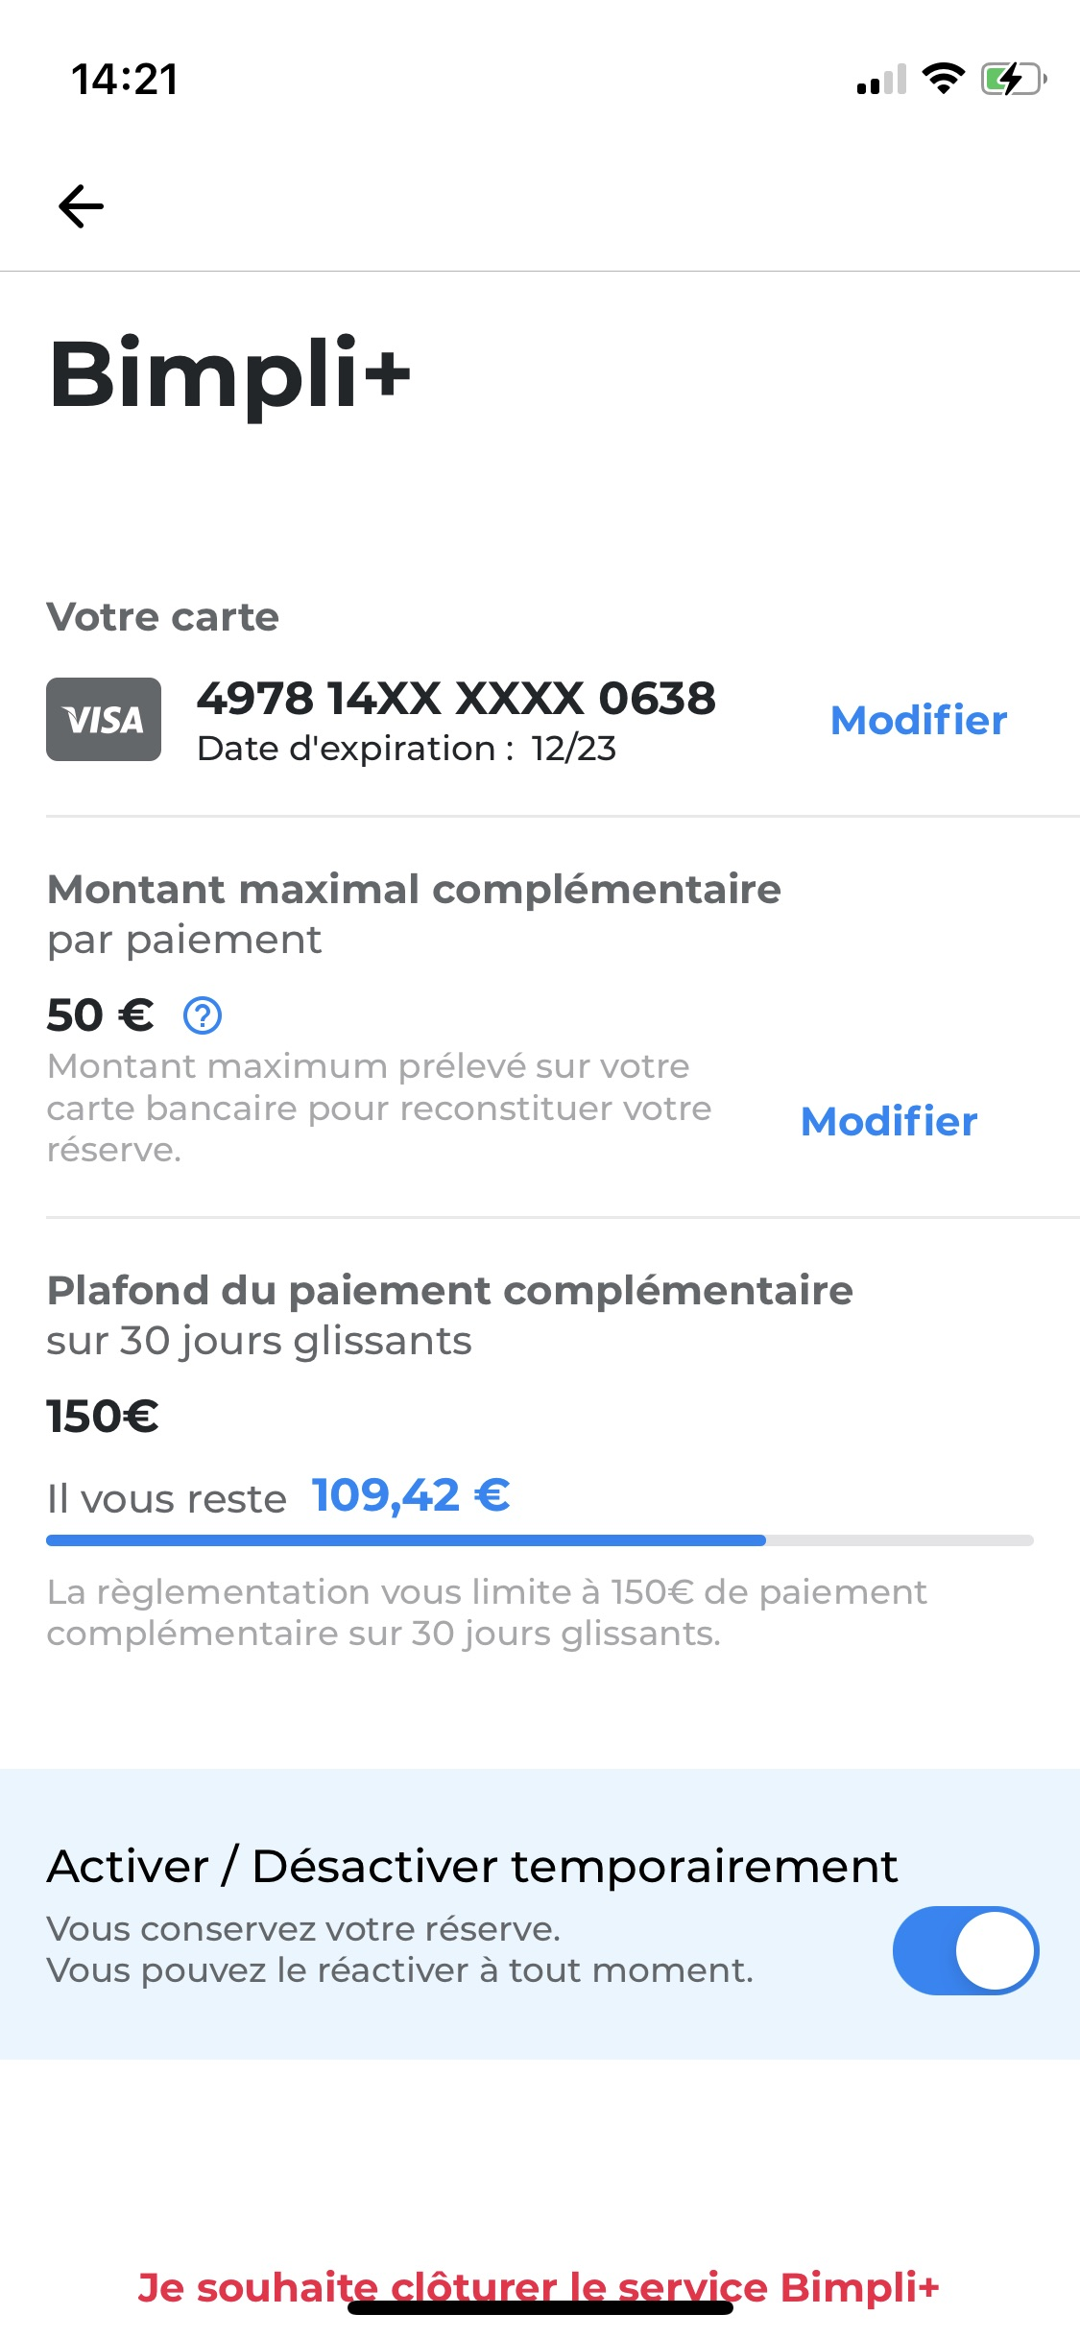
Pitch Bimpli+
Mode subscription
Je souhaite enregistrer ma carte bancaire perso Caisse d’Epargne et l’associer à ma carte Bimpli pour permettre le paiement complémentaire
Enregistrer ma carte
4978 1467 3452 8638
10
24
359
Exemple en hosted form

Slide 8
TopUP Manuel
API Parcours
5 BINs
TopUP
3DS
/api/v1.1/payins/cardpayments
Note
Texte
POST
Rechargement manuel Appel la 1ère fois et les fois d’après
Input : PAN/DFV/CVV2
Token
5 BINs
TopUP
+
Register
/api/v1.1/payins/cardpayments
Note
Texte
POST
Rechargement manuel : Appel la 1ère fois, token+appCardID permet d’enregistrer et d’associer le token à l’appCardID
1
Input : PAN/DFV/CVV2
Token
appCardID
5 BINs
/api/v1.1/payins/cardpayments
TopUP
+
Register
Note
Texte
POST
Rechargement manuel : Appel les fois d’après avec juste l’appCardID pour exécution en oneclick
2
Input : PAN/DFV/CVV2
appCardID

Slide 9
TopUP auto
API Parcours
5 BINs
TopUP
+
Register
/api/v1.1/payins/cardpayments
Note
Texte
POST
Rechargement manuel : Appel la 1ère fois, token+appCardID permet d’enregistrer et d’associer le token à l’appCardID
Mode subscription permet de passer en mode AutoTopUp par le partner
1
Input : PAN/DFV/CVV2
Token
appCardID
Subscription = true
2
5 BINs
TopUP
+
Register
/api/v1.1/payins/cardpayments
Note
Texte
POST
Rechargement auto : Appel les fois d’après avec juste l’appCardID et le mode Subscription = true (ON)
appCardID
Subscription = true

Slide 10
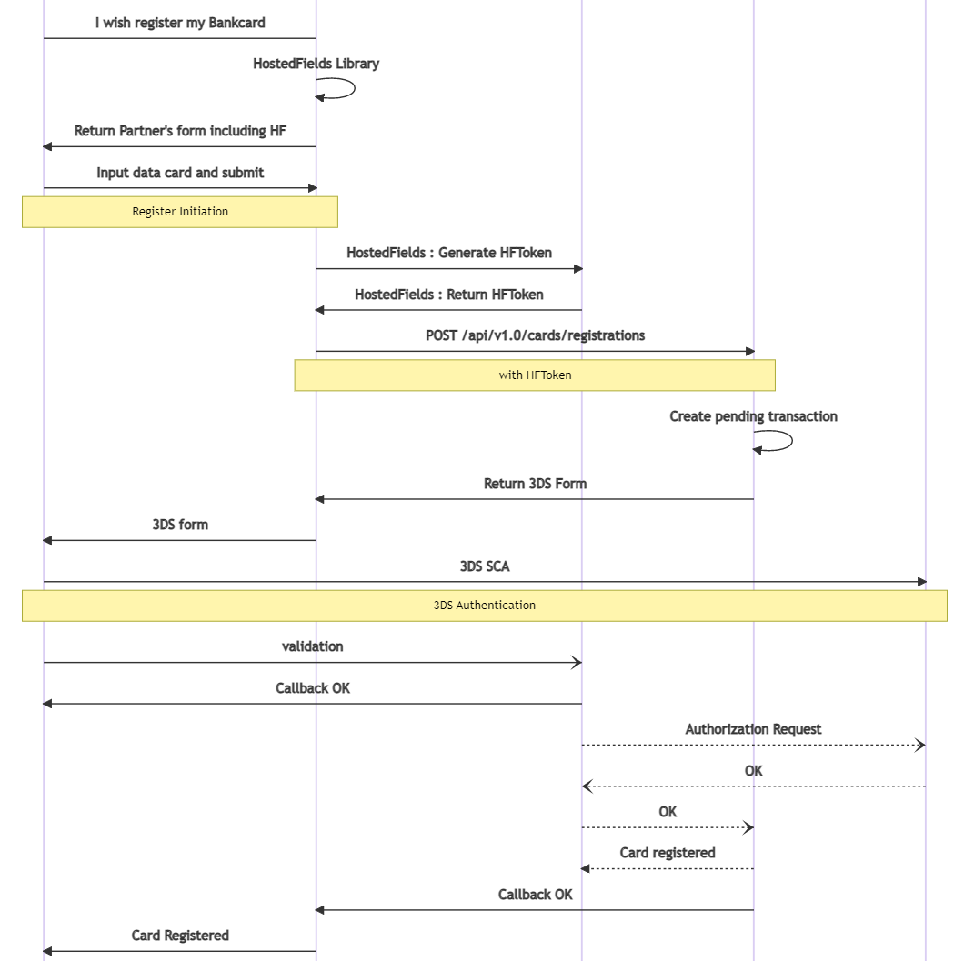
Register my card
PARTNER
Add a bank card
This part is about the card registration with a card who required a 3DS form validation (asked by the EndUser bank). Once the request sends to Xpollens, you must decode the base-64 html form to redirect the EndUser. If the 3DS form is correctly validated, the EndUser will be redirect to the “UrlReturn”.
NOTE: If the end-user fills the 3DS form and is redirected to the UrlReturn and received the confirmation OK, it does not mean that the Card is available in Xpollens system. The enduser must wait for the notification send by Xpollens. This notification will trigger the validation of the registered card.
POST Register a bank card
5 BINs
API
/api/v1.1/cards/Registrations
Note
Texte
POST
AppCardId
EN attente IT pour DEF API

Slide 11

GET/DELETE
Retrieve all registered bankcards / Cancel a bank card
The service is used to retrieve all existing bank cards already registered for a dedicated user. All information associated to the card will be displayed.
The existing appCardID (Bank card ID of third party partner) as well as the appUserID must be used to proceed
GET all registered banks cards
DELETE a bank card
5 BINs
5 BINs
API
/api/v1.1/users/{userid}/cards/registered
API
Note
Texte
Note
Texte
/api/v1.1/users/{userid}/cards/{appCardId}
GET
DELETE
userId
appCardId
CANCEL
EN attente IT pour DEF API

Slide 12
GET TOPUP
Get all topUp/ Get à topUp by orderId
This endpoint is used by a dedicated user, to consult the list of top up operations, executed from his Xpollens account.
To deal with this endpoint : The holder account must first have executed a top up operation.
This endpoint is used by a dedicated user, to consult a specific top up operation, by the orderid.
To deal with this endpoint : The holder account must first have executed a top up operation.
GET all topUP
GET topUP by orderId
5 BINs
5 BINs
API
/api/v1.1/users/{userid}/payins/cardpayments
API
/api/v1.1/users/{userid}/payins/cardpayments/{id}
Note
Texte
Note
Texte
GET
GET
UserId
Id
OrderId

Slide 13
REFUND A TOPUP
This endpoint is used to refund a top up. It is possible to fully or partially refund an operation.
By using this feature, the bank card holder will be refunded directly to his bank card, and the Xpollens account will be debited for the amount to be refunded. If there was a fee charged during the topup, then the fee will also be refunded to the bank card holder, and the Xpollens Partner's commission account will be debited with the amount of the commission to be refunded.
The amount specified in the body of the request corresponds to the amount to be refund. The fee specified in the body of the request corresponds to the fee to be refund. Each amount must be less than or equal to the initial amount of the topup. The orderid specified in the body of the request corresponds to a new orderid designating the refund operation.
To deal with this endpoint : The holder account must first have executed a top up operation
Refund a topUP
5 BINs
/api/v1.1/users/{userid}/payins/cardpayments/{id}/payments/{paymentid}/refunds
API
Note
Texte
POST
Id
PaymentId
userId

Slide 14
RESSOURCES
Main Fields
Property | Type | Input Mandatory | Description
AppAccountId | String | YES | User’s ThirdParty app identifier
urlReturn | String | YES | URL of redirection. At the end of a 3DS validation, the user will be redirected on this URL.
Status | Int | OUTPUT ONLY | Status for card registration: 0 = Waiting 1 = Completed 2 = Failed Status for Top-up transaction: -1 = unknow 0 = waiting 1 = completed 2 = refunded 3 = refused 4 = Waiting for validation 5 = Cancelled 6 = Waiting to be sent
Amount | Long | YES | Payment amount (in cents)
AuthenticationFormHtml | String | OUTPUT ONLY | Returned Authentication form (HTML form encoded in base64)
Fee | Long | N | Fee amount (the amount value does not include the fee amount)
OrderId | String | YES | Top-up identifier in the third-party application
Id | Long | OUTPUT ONLY | Top-up ID
Message | String | YES | Top-up message
ErrorCode | Int | OUTPUT ONLY | 0 = 0XXX operation succeeded or still processing 10 = 1XXX operation rejected because of bad request configuration 11 = 2XXX operation rejected because of bad reference usage 12 = 3XXX operation rejected because of bad account configuration 13 = 4XXX operation rejected because of the bank or the supplier 14 = 5XXX operation rejected because of a system error 15 = 6XXX operation rejected because of anti-fraud engine
TermsAndConditionsValidationDate | DateTime | Depends on partner parameter | Terms and conditions validation date This field is optional if the partner parameter is disable e.g: 2020-11-10T11:16:29.054+01:00

Slide 15
RESSOURCES
Objects
AccountREF
Card
Property | Type | Input Mandatory | Description
Id | Long | OUTPUT ONLY | Account identifier.
AppAccountId | String | Yes | Account identifier provided by the third-party application.
DisplayName | Long | OUTPUT ONLY | Account display name
Email | String | OUTPUT ONLY | Account email
Phonenumber | String | OUTPUT ONLY | Account phone number
Href | Uri | OUTPUT ONLY | Uri for the account details
Property | Type | Input Mandatory | Description
Id | Long | OUTPUT ONLY | Card ID
AppAccountId | String | Yes | AppAccountId of the card user.
AppCardId | String | NO | Card identifier in the third-party application.
Network | Long | OUTPUT ONLY | UNKNOWN = -1, CB = 1, MASTERCARD = 2, VISA = 3,
Hint | String | OUTPUT ONLY | Hide the card number. 6XXXX4 format
Country | String | OUTPUT ONLY | ISO country code of the card
ExpiryDate | Date | OUTPUT ONLY | Card expiration date
Status | Int | OUTPUT ONLY | Status value available : Pending = 0, Succeeded = 1, Failed = 2

Slide 16
RESSOURCES
Objects
Holder/PayerInfo
ExtraResults
Property | Type | Input Mandatory | Description
Name | String | YES | The holder’s full name (as described on the payment method).
Mail | String | YES | The user’s email.
UserAgent | String | YES | The user’s browser informations
UrlReferrer | String | YES | Url
IpAddress | String | YES | The User’s IP Address
Property | Type | Input Mandatory | Description
threedsecure | Boolean | OUTPUT ONLY | True / False
threedsecureauthstatus | Int | OUTPUT ONLY | 0 = Yes 1 = No 2 = unavaible 3 = Attempted
threedsecuresignaturestatus | Int | OUTPUT ONLY | 0 = Yes 1 = No
threedsecureglobalstatus | Int | OUTPUT ONLY | 0 = Yes 1 = Not_enrolled 2 = unavaible 3 = Not_required
ThreeDsCardEnrolled | Int | OUTPUT ONLY | 0 = Yes 1 = No 2 = unavaible
ExecCode | String (4) | OUTPUT ONLY | The operation result code
ExecMessage | String | OUTPUT ONLY | The operation result description linked to EXECCODE
warrantyresult | String | OUTPUT ONLY | Yes / no
3dsecureversion | Int | OUTPUT ONLY | The kind of 3-D Secure protocol version. Ex: 1
bankauthresult | Int | OUTPUT ONLY | Return code of the authorisation request returned by the issuing bank

Slide 17
Hosted Fields Integration (1/2)
You must own a TLS certificate to host a valid HTTPS payment page, otherwise the user’s browser will display security alerts and is likely to block it.
The hosted-fields library must always be called online. Using a downloaded version hosted on your own server can cause serious malfunctions, especially in the case of an update of the API.).
1
First, you must include the Dalenys hosted fields dedicated library, by adding the following code between the <head> and </head> tags in your HTML:
<script type="text/javascript" src="https://js.sandbox.be2bill.com/hosted-fields/v1/hosted-fields.min.js"/>
<script type="text/javascript" src=" https://js.sandbox.be2bill.com/brand-detector/v1/brand-selector-widget.min.js "/>
Declare the UTF-8 encoding
<meta charset="UTF-8">
Create a <form> </ form> form with 4 containers identified by an id attribute. The choice of the identifier used is free but must be unique and will be used in the javascript code presented in the following points.
In the following example, we are generating a payment form using 4 span tags as containers:
<form method="post" action="URL">
<span id="card-container"></span>
<span id="expiry-container"></span>
<span id="cvv-container"></span>
<span id="brand-container"></span>
<input type="submit" value="Pay">
</form>
The URL to enter in the action attribute will the URL specify on the documation below (See request of Card registration and Top-up).
4
Configure the hosted fields library
The next step is to designate the containers in which to create the secured hosted fields, using JavaScript. To do so, initialize the hosted-fields library with your Public API Key and your desired configuration: S-money must provide the necessary keys to the hosted fields.
<script type="text/javascript">
// Initialize the hosted-fields library
var hfields = be2bill.hostedFields({
// Use your Public API Key
key: {
id : ‘XXX’
value : ‘XXX’
},
// Link and configure each hosted input field by providing the corresponding container ID
fields: {
'card': {
id: 'card-container',
//enable the card field format auto spacing
enableAutospacing: true
},
'expiry': {
id: 'expiry-container'
},
'cryptogram': {
id: 'cvv-container'
},
'brand': {
id: 'brand-container'
}
},
// Choose the language for error messages
location: "fr"
});
</script>
The identifiers used in the script to designate the fields are those used for the identifiers of the containers created in the form. This allow the script to inject the fields hosted by Dalenys in these containers.
2
3

Slide 18
Hosted Fields Integration (2/2)
Load the hosted fields library
<script type="text/javascript">
hfields.load();
</script>
At this point, your web browser may display the bank card input fields into their containers.
Token generation
Once the user submits the form, you should call the createToken method to trigger the tokenization process.
This method expects a callback in parameter which will be triggered once the tokenization request is finished.
Your callback will receive a result object containing these properties:
execCode: The technical result code of the tokenization call. In case of success, 0000 will be sent
message: The description linked to the execCode
cardType: The card type
cardCode: The first 6 and last 4 digits of the cardholder’s card number
cardValidityDate: Card expiry date
selectedBrand: Cardholder selected brand in case of co-branded card.
hfToken: Of course the generated token
In case of success you have to add the received token to the form submit request (by adding an hidden input for example) :
5
6
<form method="post" name="formName" action="SMONEY-API-URL.com/action" onsubmit="return tokenizeHandler()">
<!-- ... -->
<input type="hidden" name="hftoken" id="hftoken">
<!-- ... -->
</form>
<script type="text/javascript">
function tokenizeHandler() {
hfields.createToken(function (result) {
//console.log(result); // Debug
if (result.execCode == '0000') {
// Set the token in an hidden input field to transmit it to the merchant
document.getElementById('hftoken').value = result.hfToken;
// Send the form request
document.formName.submit();
}
});
// Prevents the submit of the form in case of failed tokenization request
return false;
}
</script>
Plus d’infos sur : Hosted-fields (dalenys.com)

Slide 19


Hosted Fields containers
Partner Payment Form
PAN
Brand
DFV
token
CVV2

